Slide 1
VSD-BGR-DESIGN WORKSHOP
NARESH KUMAR G

Slide 2
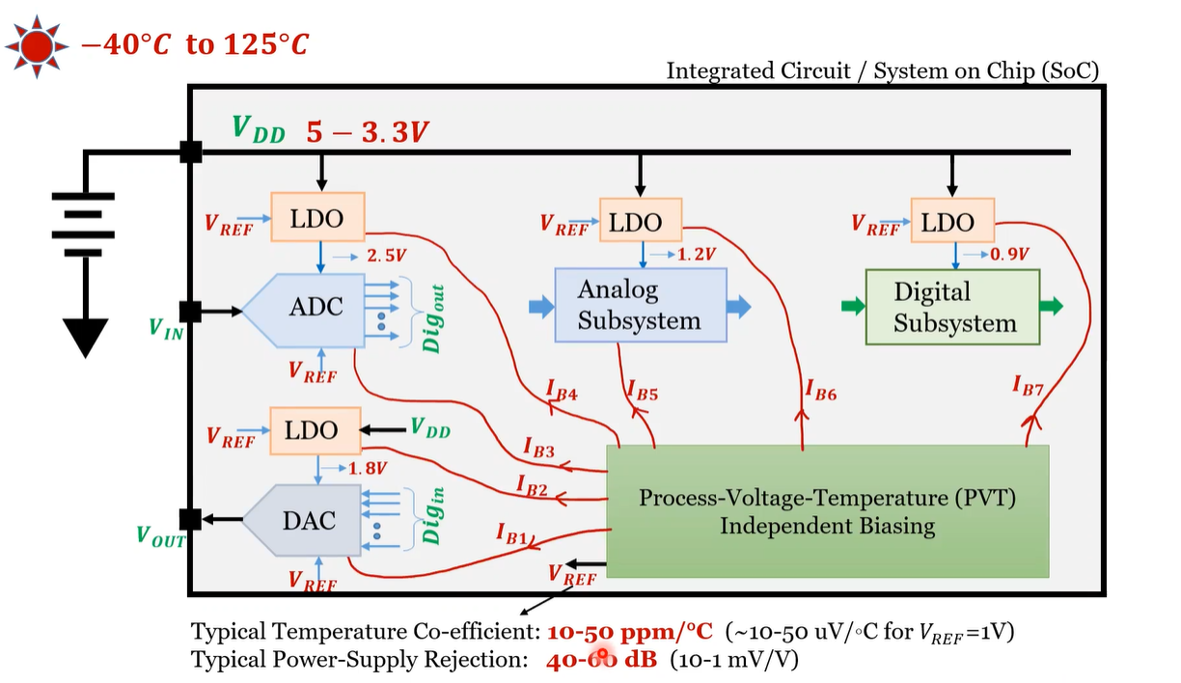
Voltage refs are needed for ADC, LDO, Buck conv, bias circuits

Slide 3
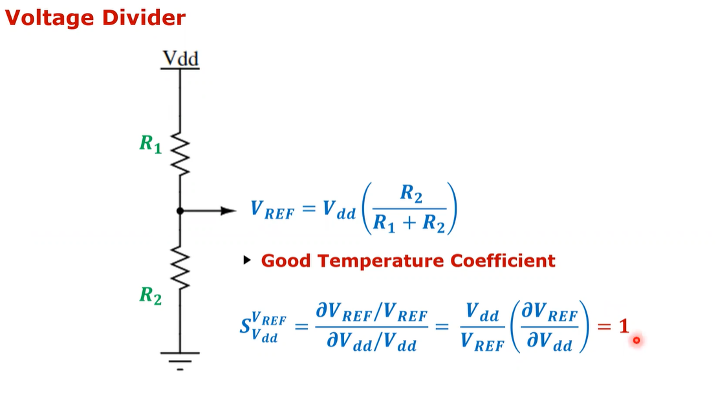

Slide 4
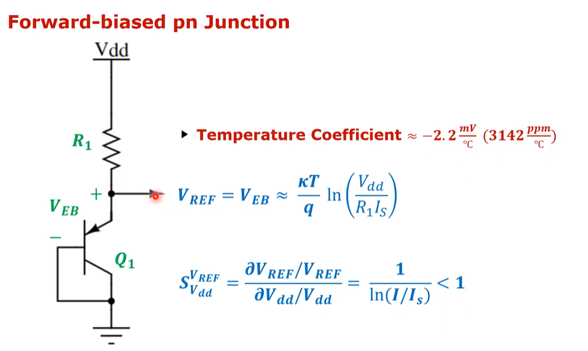

Slide 5
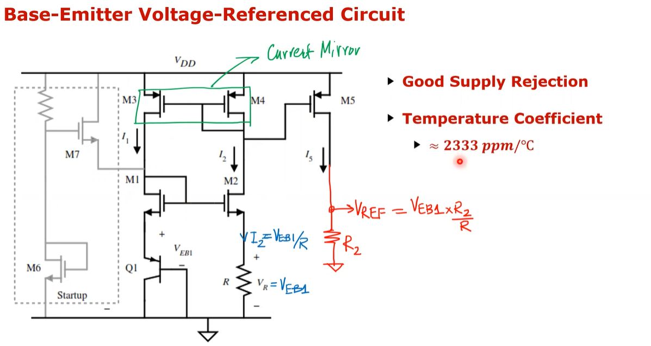
The current mirror improves supply rejection but the temperature coefficient is still high M1 , M2 also form a voltage mirror since now M1 and M2 also have same current => VG1 and VGS2 should be the same
Since Vg1 = Vg2 => Vs1 = Vs2 = Veb1

Slide 6
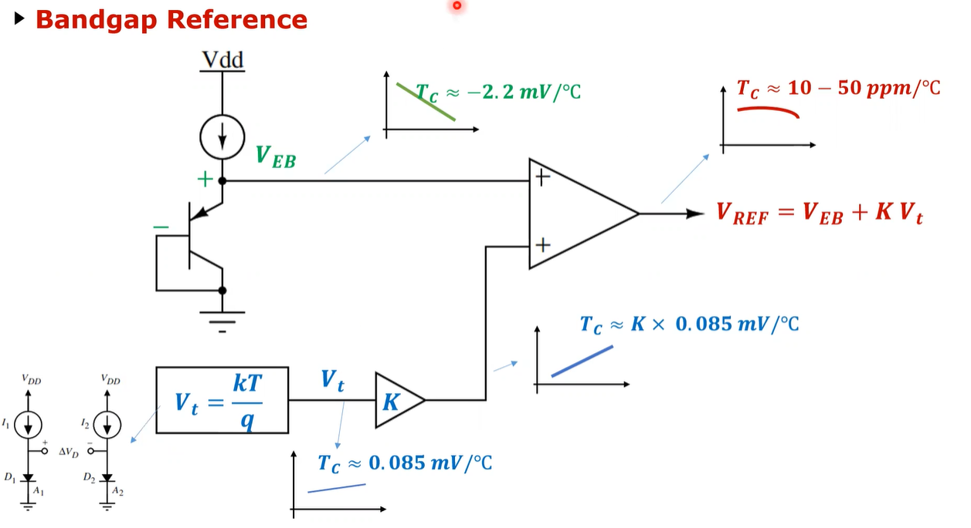
The positive slope Vt can be generated using two diodes which are forwards biased

Slide 7
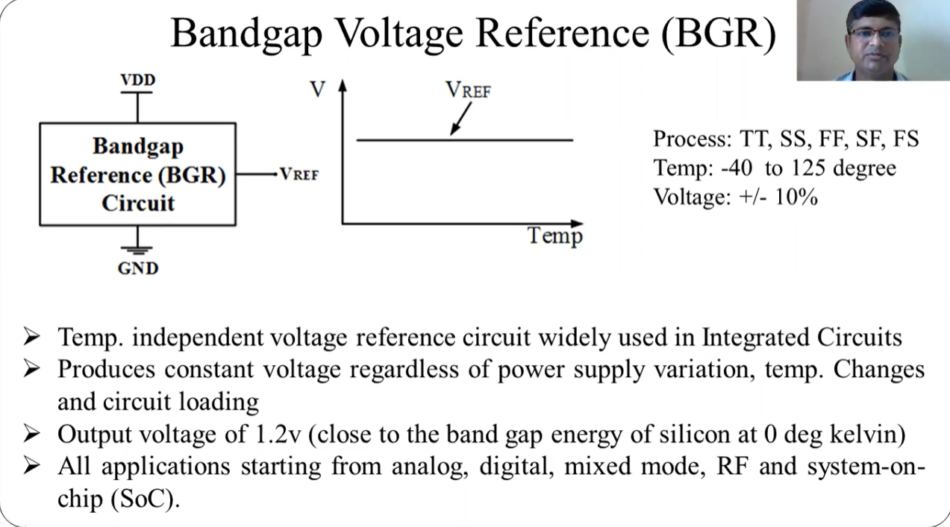

Slide 8
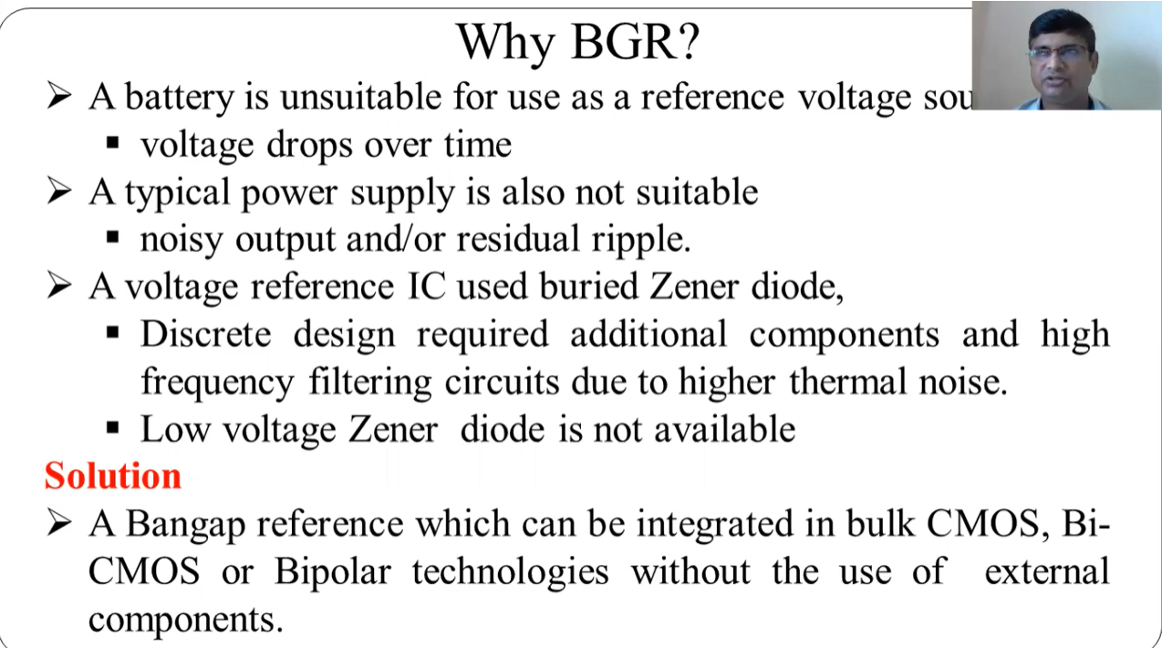

Slide 9
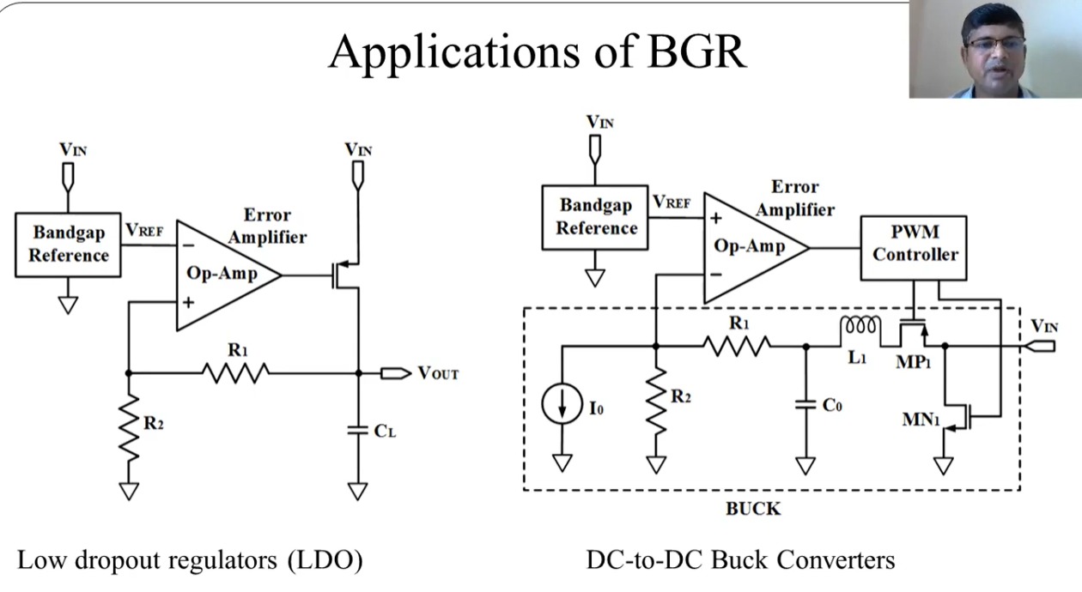

Slide 10
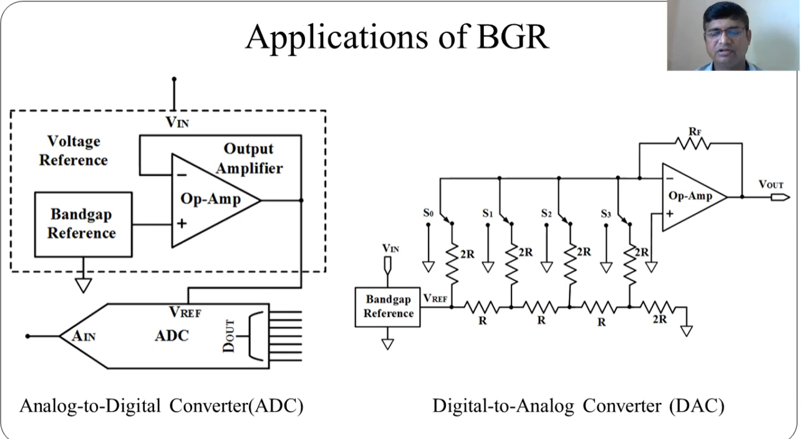

Slide 11
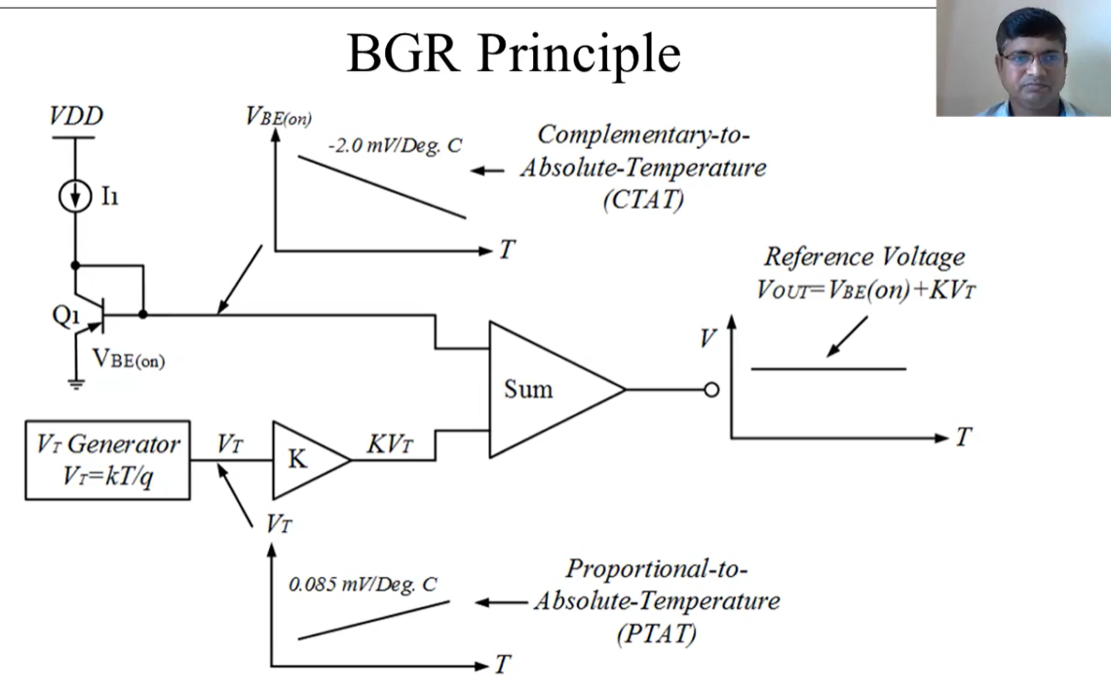

Slide 12
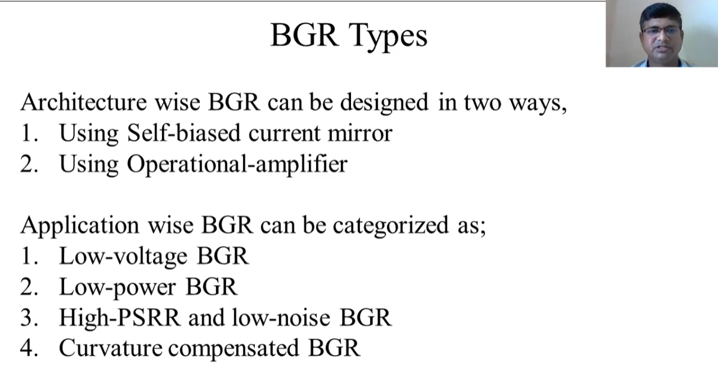

Slide 13
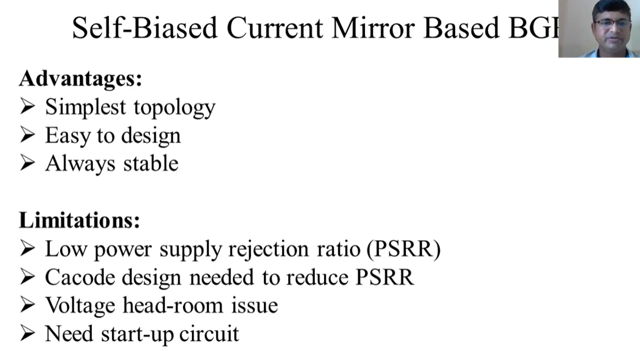

Slide 14
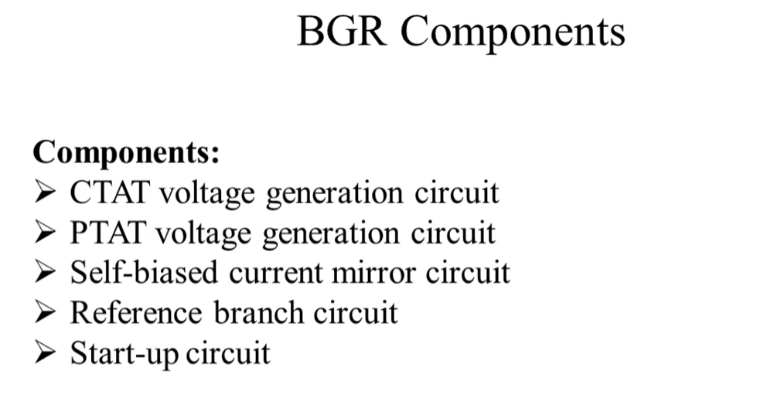

Slide 15
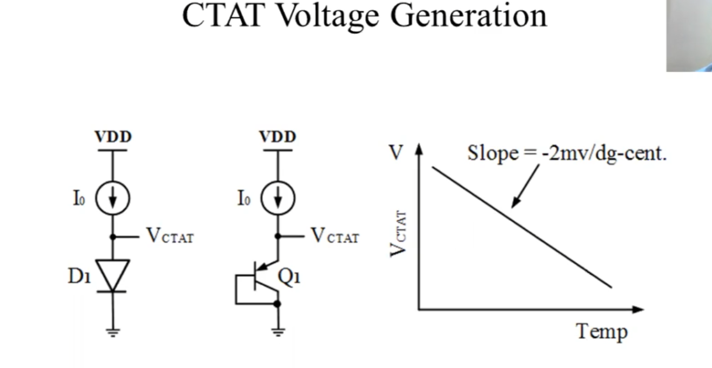

Slide 16
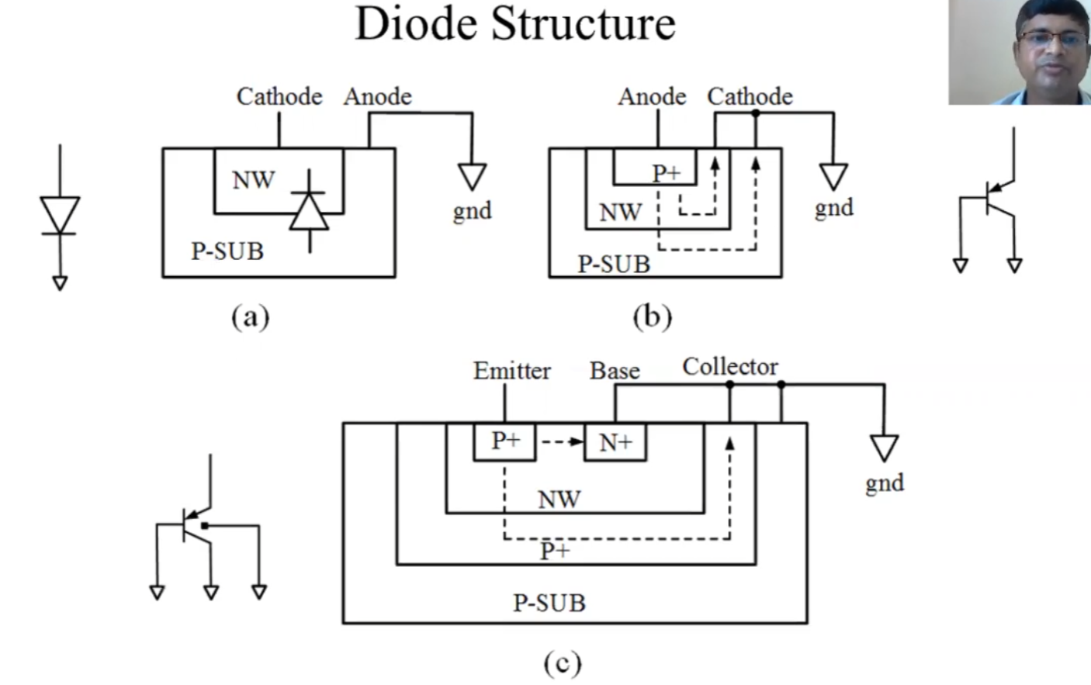
Why use a BJT in diode fashion why not a diode directly? Becuase whe n a didoe is used we we need its anode to be connected to GND to forward bias it. In that way the P_Substrate is actually connected to a potential and not to ground which is the usual connection in BiCMOS process node. So to avoid biasing the substrates of the other devices we use a BJT connected in a diode fashion.
Why not option b? Becuase we can see some collector current going through the P substrate which is not supposed to be carrying any current
Why option c? Becuase most of the collector current will not flow through the P+ doped region and not the P substrate of the device

Slide 17
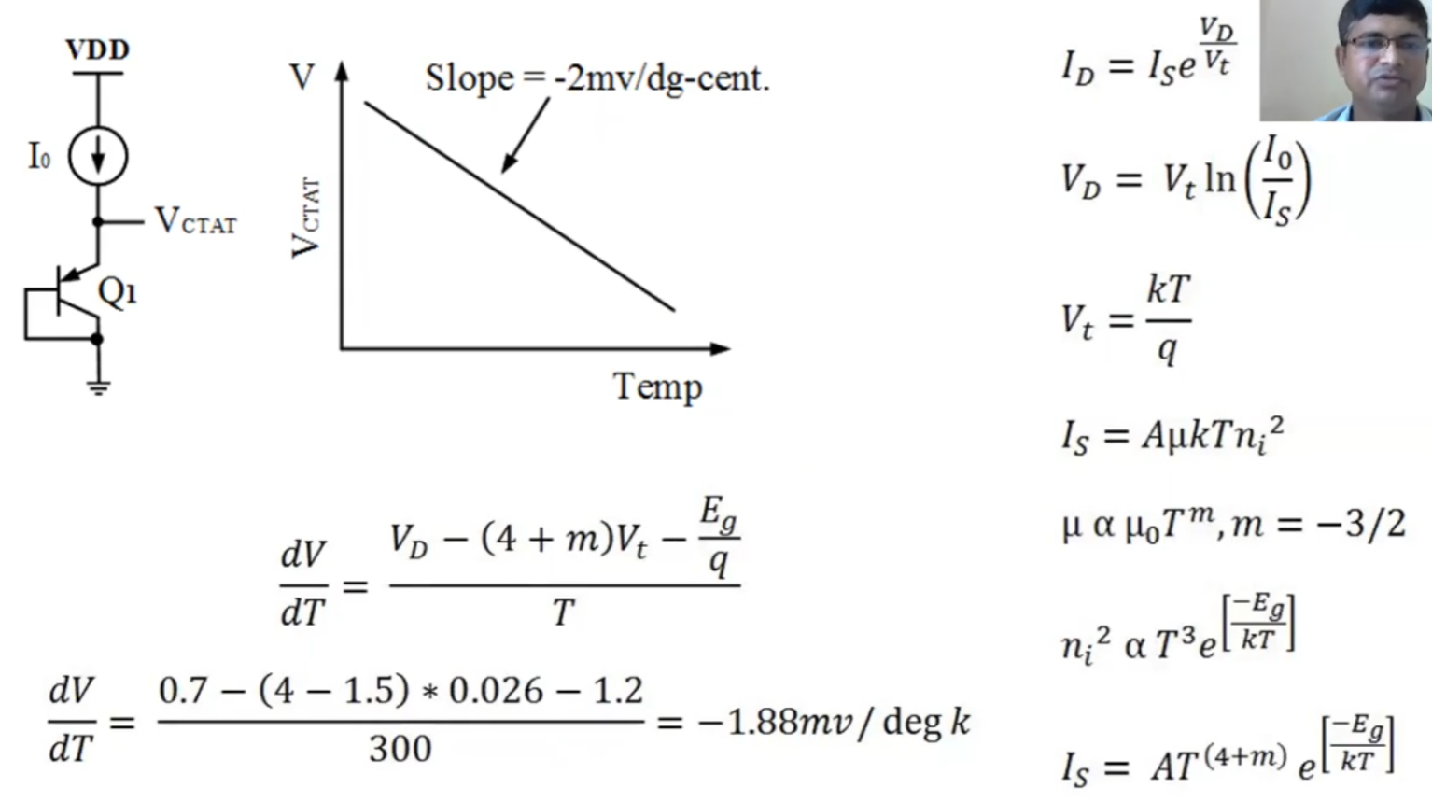
More info and derivation in the pdf fill attached along with this document

Slide 18
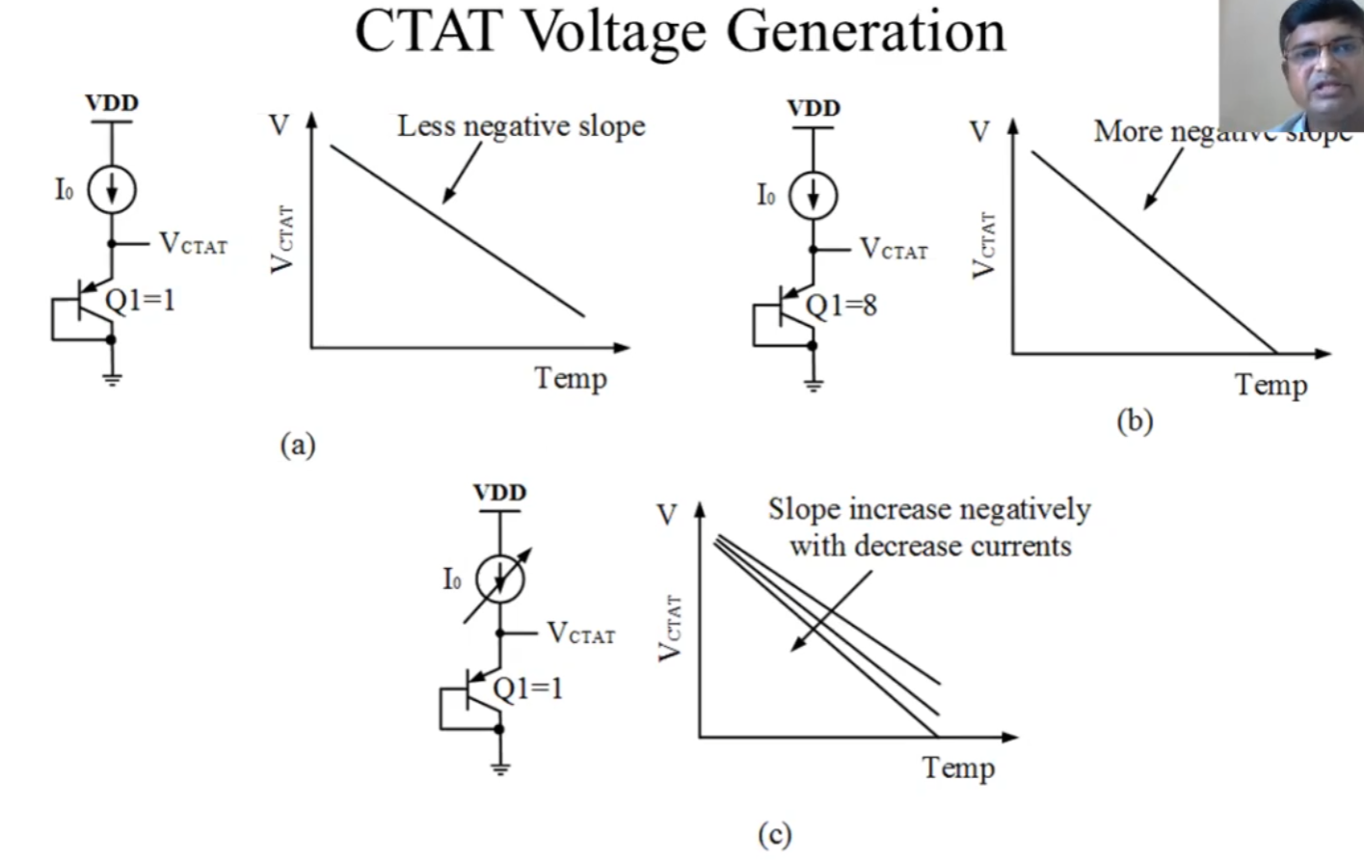
Other important relationships: If more devices are added in parallel with the BJT then the slope becomes more -ve since more devices => more variation w.r.t to Temperature i.e. dVbe/dT gets added
If Ic is lower => Vbe is lower From the previous eq, dVbe/dT becomes even more -ve

Slide 19
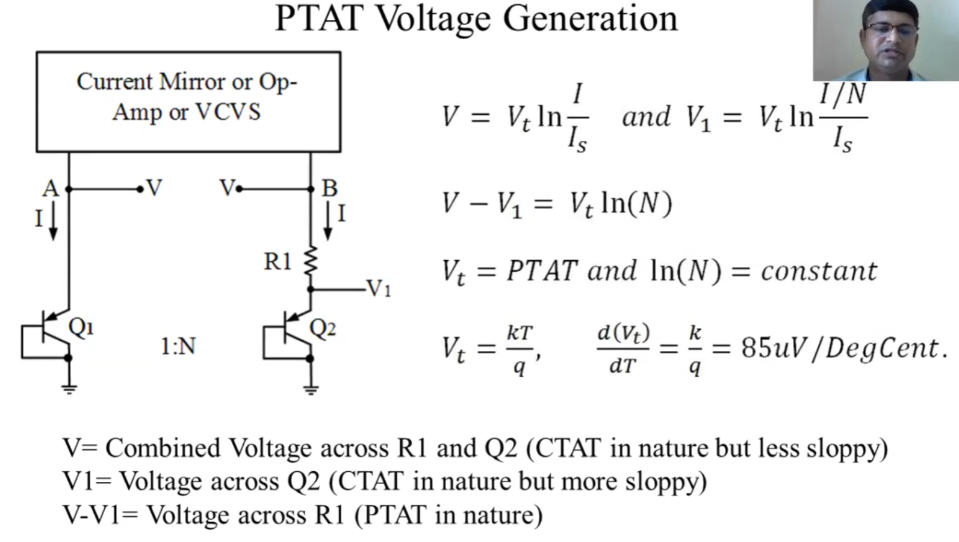
Current mirror or OPamp or VCVS basically to put a nullator at the input to either match the currents or voltages

Slide 20
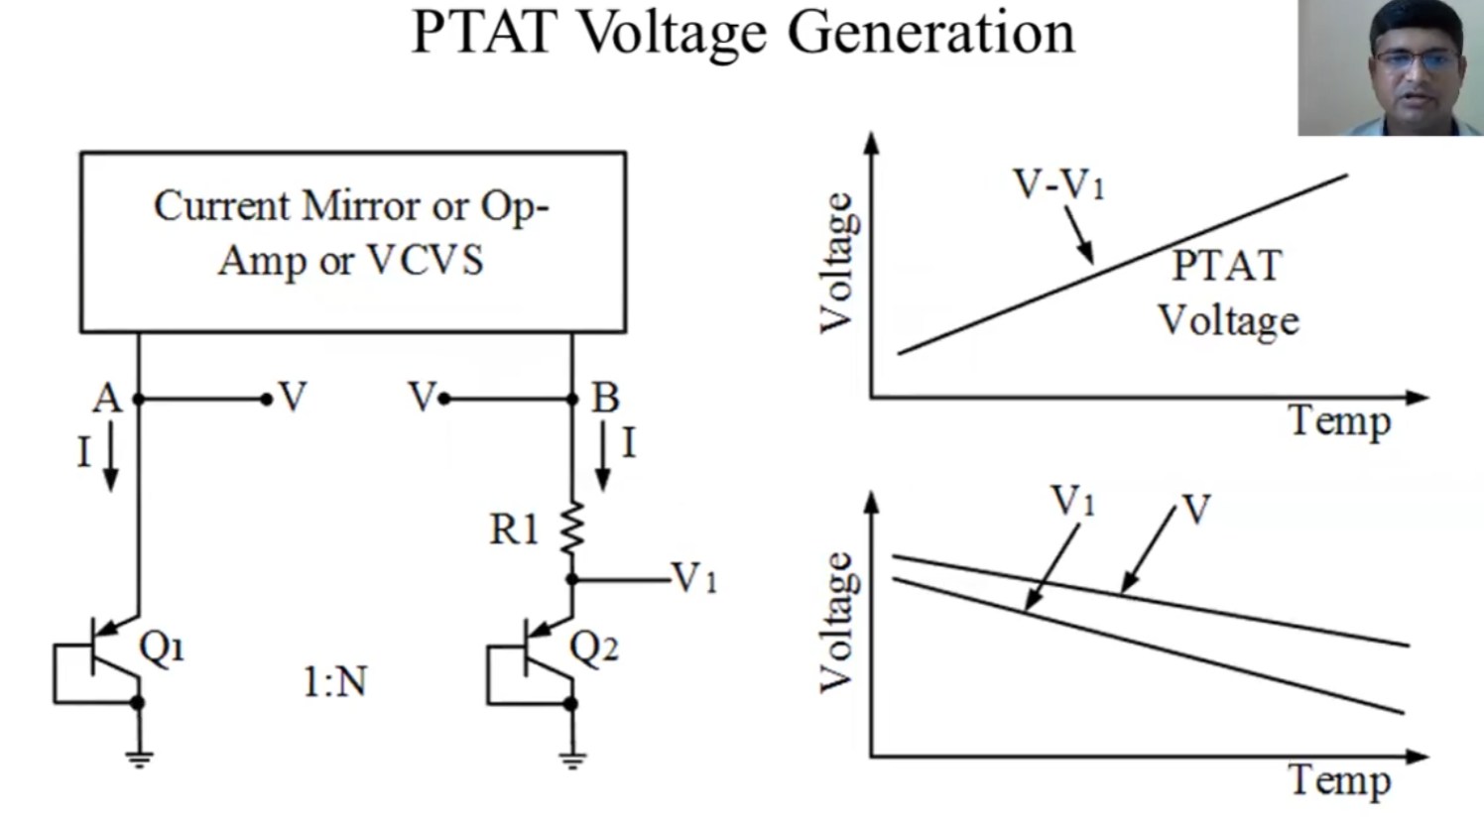
V1 curve will have a more -ve slope because it has lower current flowing through it. Hencce providing a +ve slop for PTAT Also PTAT is actually the voltage output across the R1 resistor

Slide 21
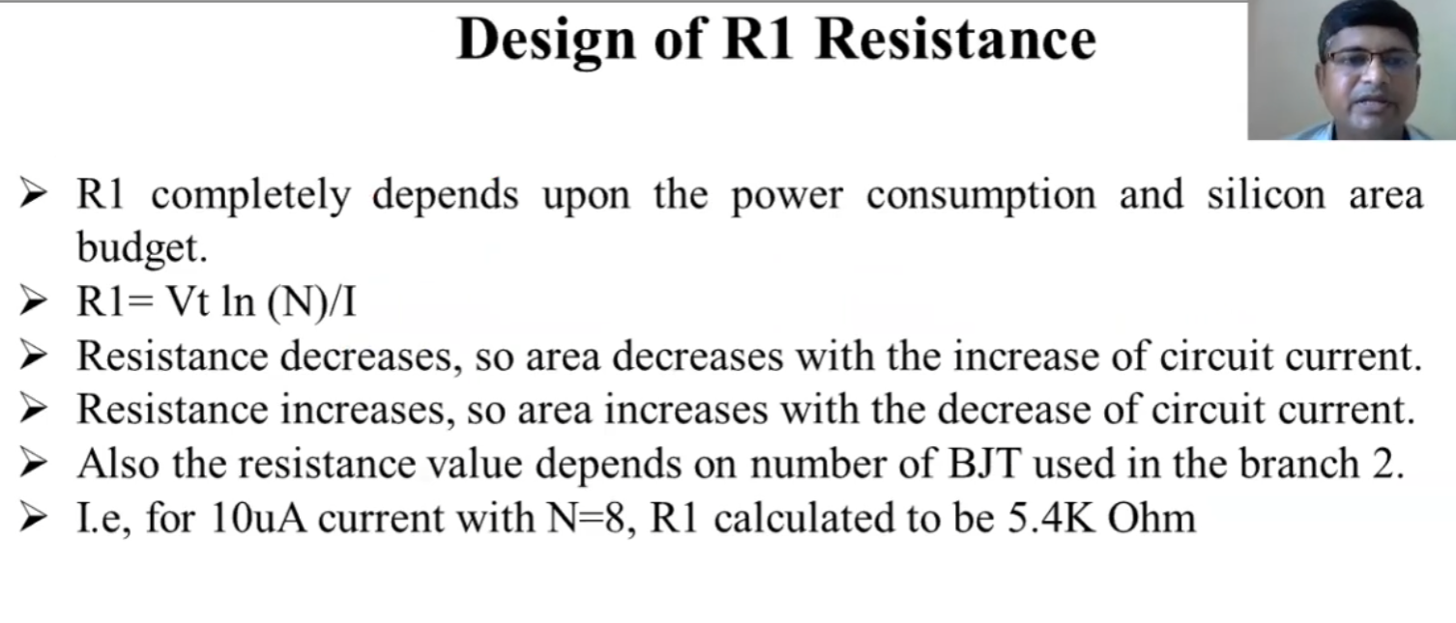
temperature dependence of the resistance is usually ignored in the PTAT sources

Slide 22
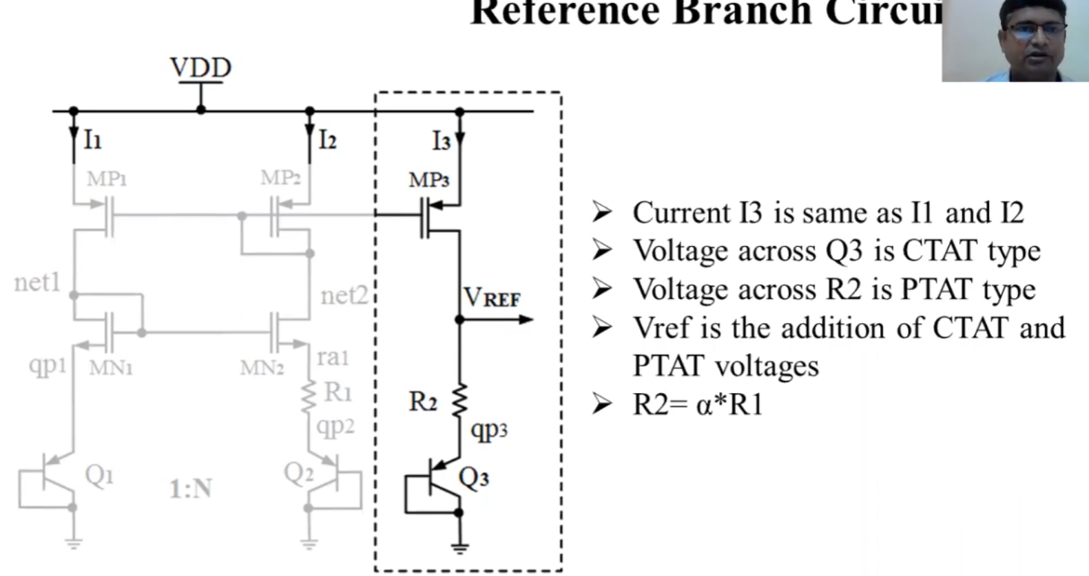
Now MP1, MP2 and MP3 form a current mirror => I1 = I2 = I3 Since I1 = I2, Vgsmn1 = Vgsmn2, which is the requirement of the PTAT. Hence the first two columns make the PTAT source across R1 i.e. Vptat = I2*R1. Now since I3 = I2 => voltage across R2 is proportional to Vptat and Q3 makes the CTAT. Hence Vref = Vptat + Vctat. The alpha is the factor that can be used to make the slope of Vref w.r.t T = 0

Slide 23
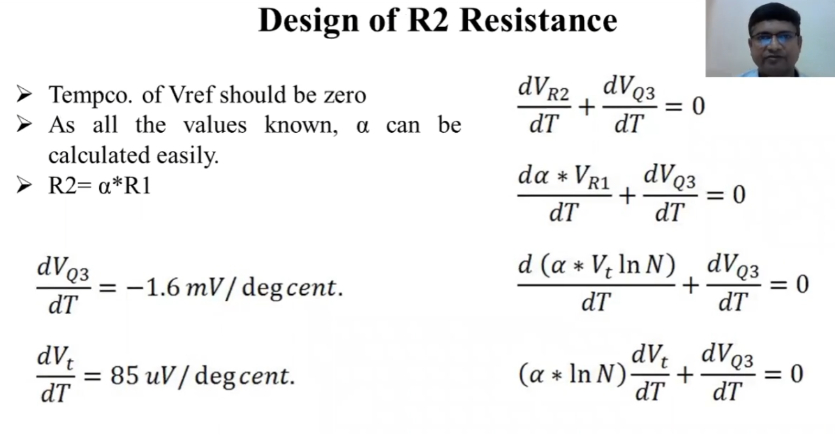

Slide 24
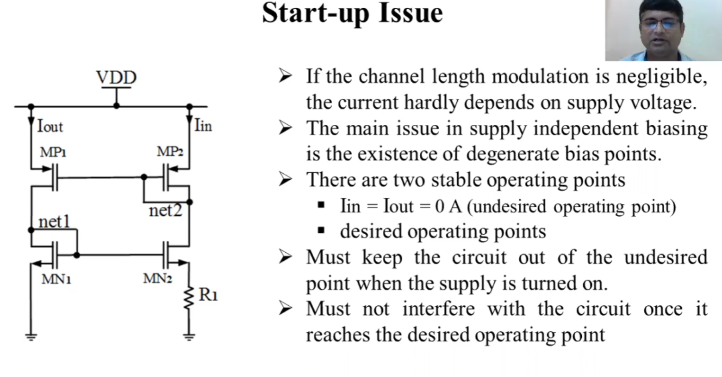

Slide 25
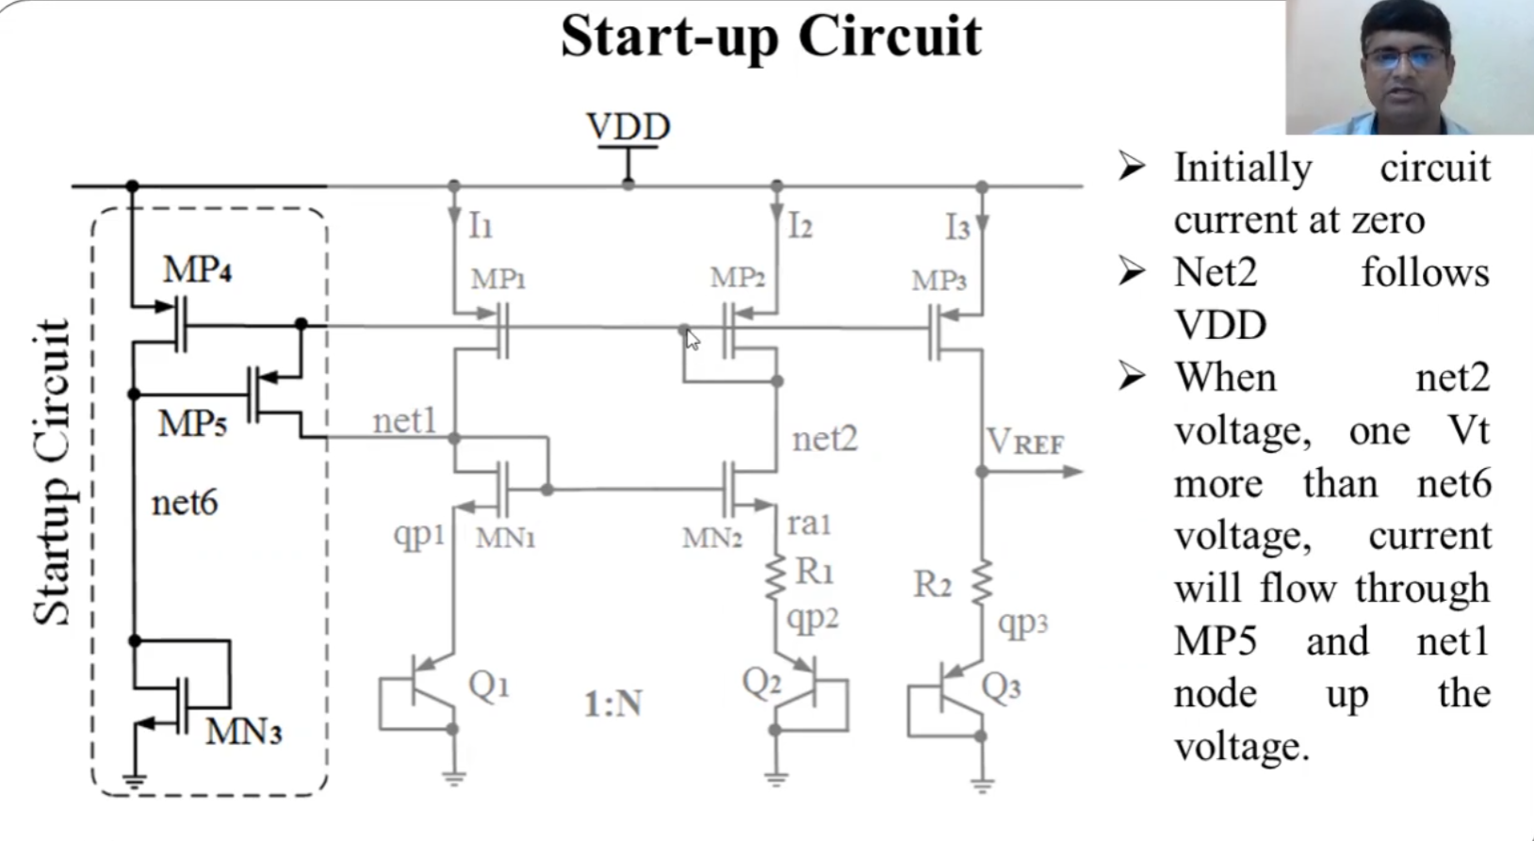
Initially with Vdd = 0, all currents = 0, when Vdd goesup, assuming there is no startup circuit and hence there are no biasing voltages for any transistor to generate the current and all are off. net 2 will follow Vdd since I2 = 0 and net 1 will remain GND since I1 = 0. This is why a startup circuit is needed.
What does a startup circuit do? net2 = Vdd initially. Since MN3 is always in saturation => it is ON automatically
=> net 6 will be pulled towards GND becasue Mn3 decides its own Vds
=> Mp5 turn onwhen Vgsmp5 >Vt
=> current flows through net1/MN1. Since Mn1 is diode connected => Mn2 turns on as soon as its Vgsmn2 > Vt => net2 is pulled low acc. to Mn2 Vds
=> MP2, MP1 turn on and MP5 turns off since Vnet6 - Vnet2 will not be > Vt
There are few other things to note here. In the beginning, MP5 is off => Vgsmp5 = 0 => MP4 is diode connected in a way and hence current flows through MP4 The current needed provided by MP5 actually comes from MP2 (diode connected FET). There is a small positive feedback loop here which is triggered by MN3. After trigger i.e.e MP5 is ON, it will increase net1 towards Vdd and turn ON MN2 which in turn provides the current to MP5 to provide the current to MN1

Slide 26
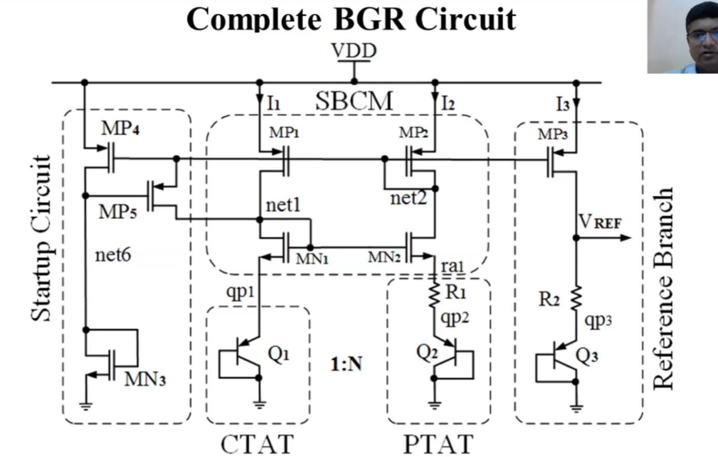
Most important design choices are R1 and R2. The sizes of the tansistors can be chosen based on the current consumption which in turn will tell us what Vt we can choose. The choice BJTs will not particularly effect the design choice. and ofcourse MP4, MN3 will consume some current so need to keep that in mind
The PSRR of this circuit with current mirrors is low. Change in VDD will also result a similar change in Vref.
To avoid this cascoded current mirrors can be used but it should be designed with care since the FETs will not have lower voltage headroom

Slide 27
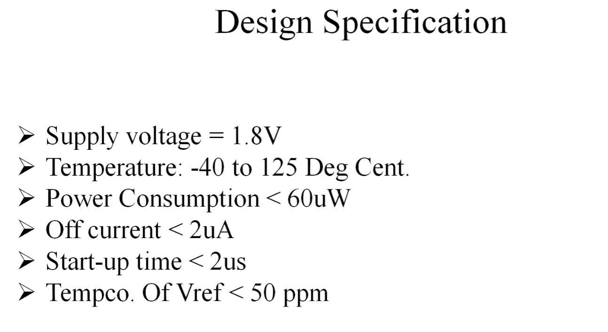

Slide 28
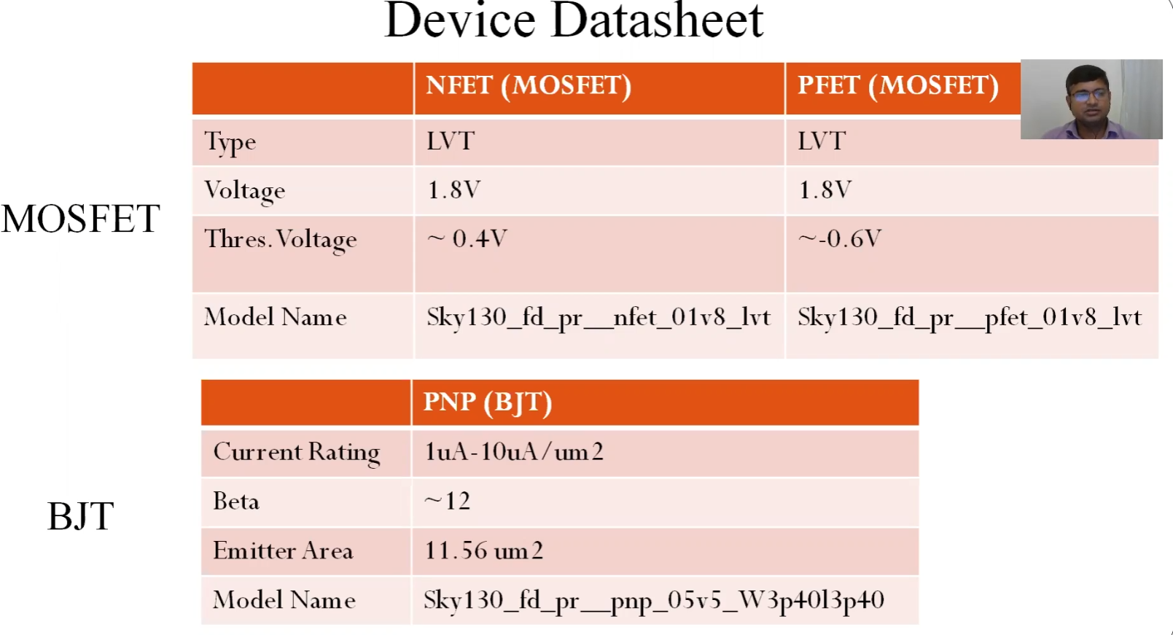
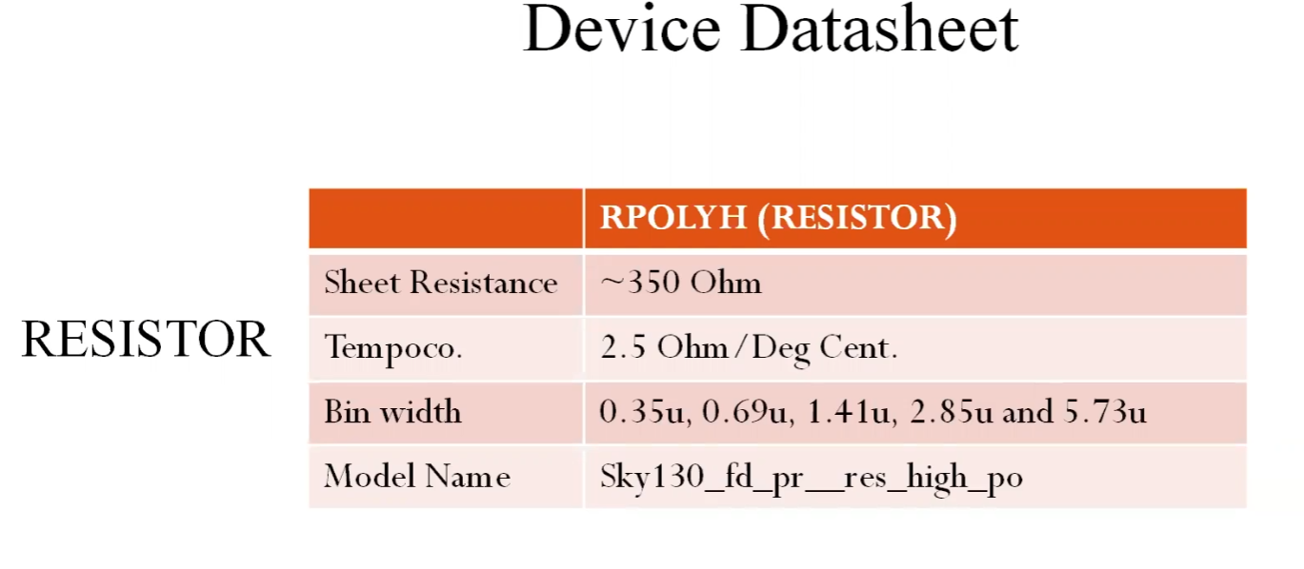
- We are using LVT (low threshold voltage) FETs to have more voltage headroom for the devices - We are using this BJT since it have large emitter area

Slide 29
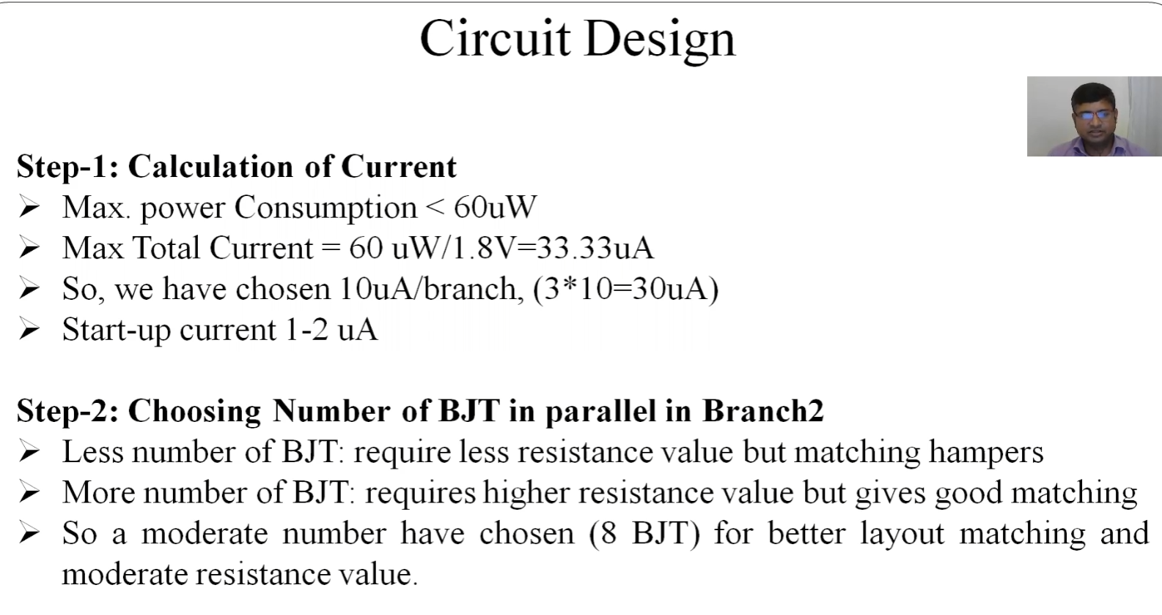

Slide 30
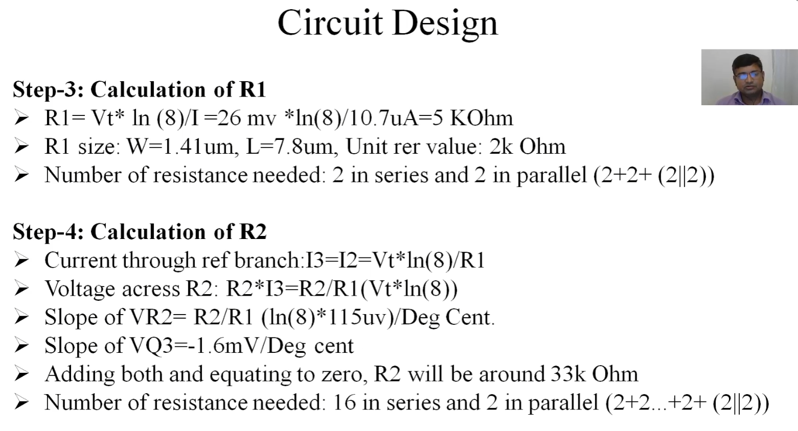
R1 can be calculated from the PTAT equation. R2 can be calculated from the refernce branch equation where the PTAT and CTAT are summed up. Notice that the PTAT temp coefficient is not 85mV/deg C but it is chosen as 115mV/degC. This value is the sum of both PTAT and the resistors temp coefficient
Given sheet resistance of the model is 350ohms & resistance = sheet_res*(L/W)
per unit resistance = 350*(7.8/1.41) = 1.936kohms

Slide 31
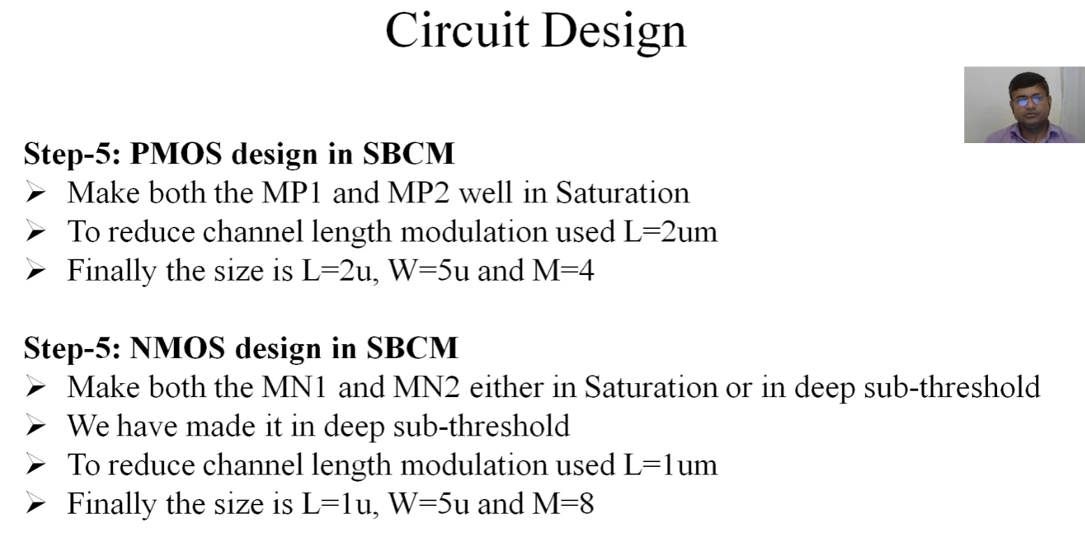
MP1 and MP2 are the primary current sources so they need to be saturation. Therefore for a current of 10uA, the following L, W and M are chosen depending on the voltage headroom
MN1 and MN2 form the nullator at net1 and net2 i.e. making Vnet1 = Vnet2. Therefore they need to be either in sub-threshold (like the input stage of an amplifier) or saturation region (like the gain stage of an amplifier). M is taken 4 and 8 to avoid PVT variations and more robust current sources

Slide 32
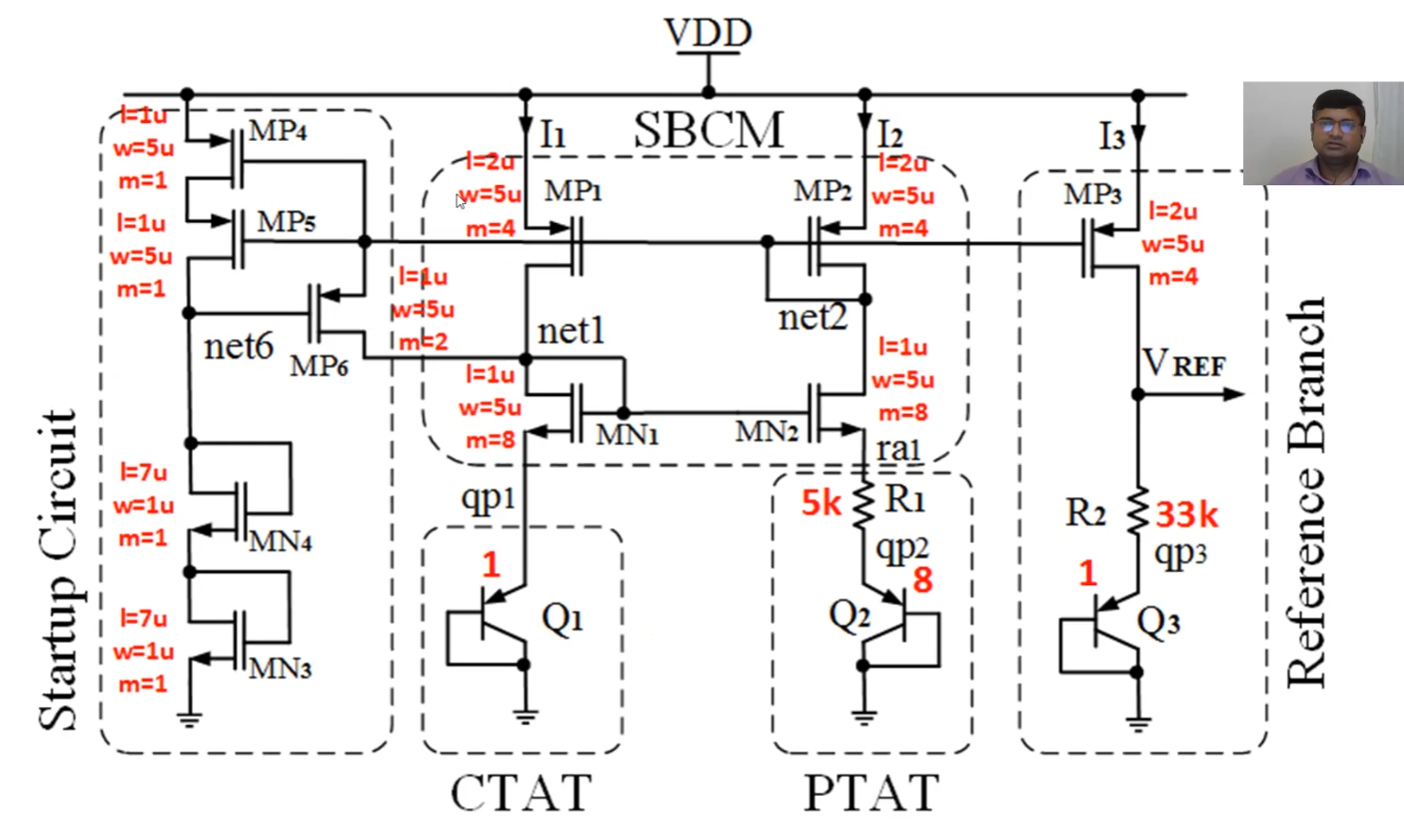
The startup circuit’s design choices: MP4, MP5 are needed to provide a high resistance when not in use => very low leakage current. So MP5 is cascoded i.e. common gate or in series. They just need turn ON and turn OFF MP6 so a small device is a good choice.
MP6 needs to provide the 1 to 2uA startup current so m is taken as 2
MN3 and MN4 are the diode connected loads. They should not consume a more current hence long length
Two FETs are in series to reduce the high VDS/VGS across the device and increase Vth.

Slide 33
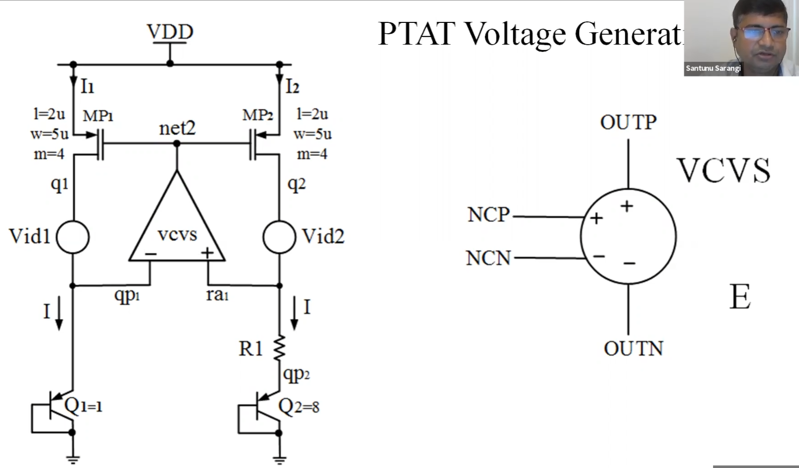

Slide 34
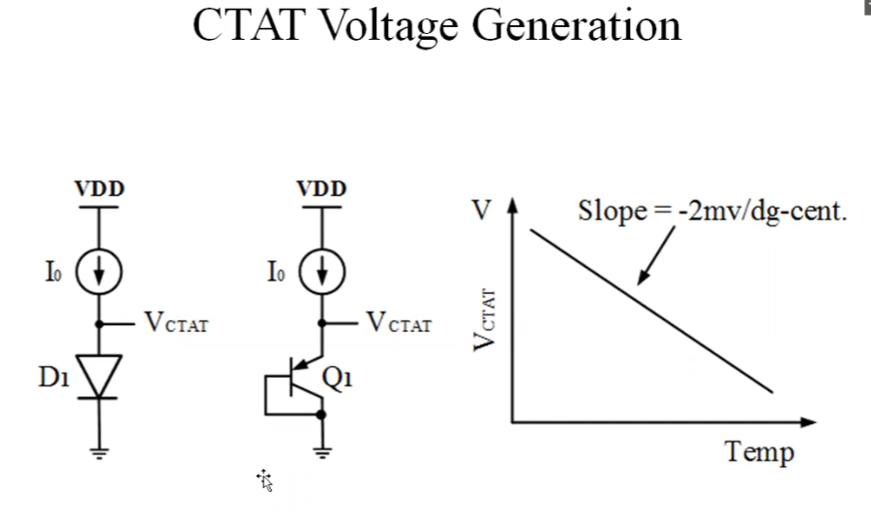
The slope is not exactly -2mV/degC. It is actually less around 1.7 to 1.6 mV/degC

Slide 35
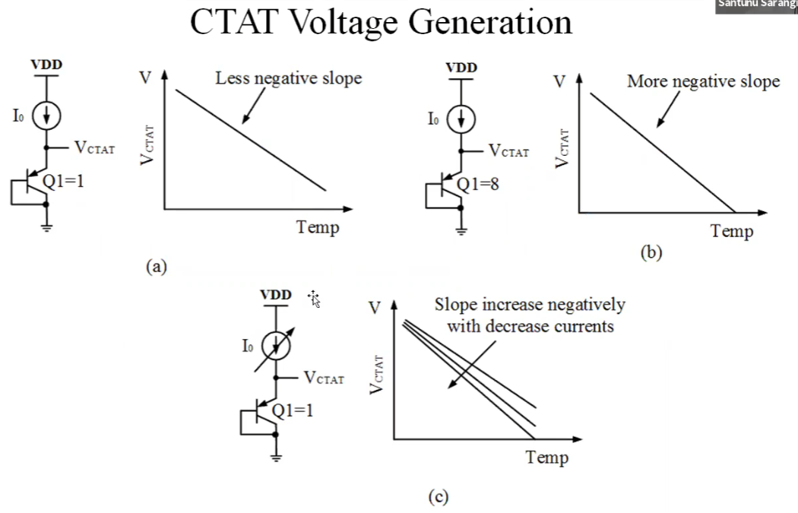

Slide 36
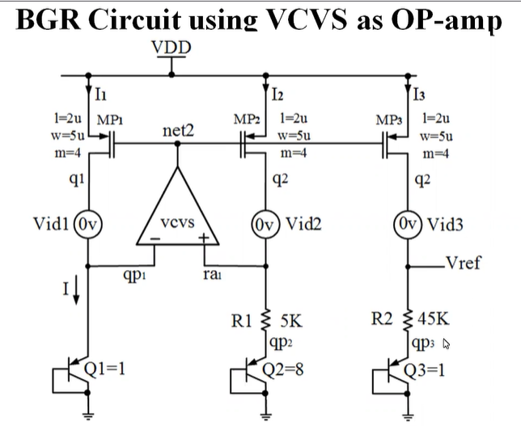
R2, is higher to increase the positive temp coefficient of PTAT votlage

Slide 37
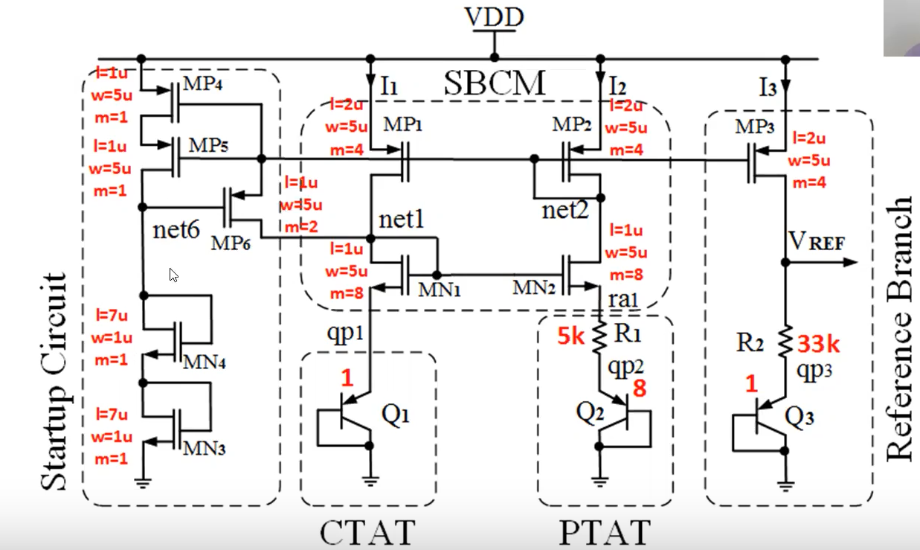
MORE DETAILED STARTUP CIRCUIT: Added mn4 to increase the gate voltage of mp6 to reverse the vgs below vt so that startup circuitry will be disconnected from main circuitry.

Slide 38
Ideally, match every type of device.
To match the BJTs, it is nice to put Q1 and Q3 close together and 4 devices of Q2 beside Q1 and Q3 each
Place dummy BJTS/FETS around Q! so as to kind of isolate The BJT structures from the other devices/substrate
Match R1, R2 by closely placing each unit. Normally rows of similar units are used.
MP1, MP2, MP3 FETs are the most important devices that need matching as they are current mirrors
So again match them and place dmmy FETs around
Match MN1. MN2 by closely plaing these devices. Again note identical devices are generally
placed in a row if devices.
Startup circuit is not so important in terms of matching etc. So try to put them in a
layout closer to the nets I guess
For extracting spice parameter from layout:
Type in the following commands after loading the appropriate
cell/layout
extract all
ext2sim label on
ext2sim
ext2spice scale off
ext2spice hierarchy off
ext2spice

